Slide 1
Snake ID Practice

Slide 2
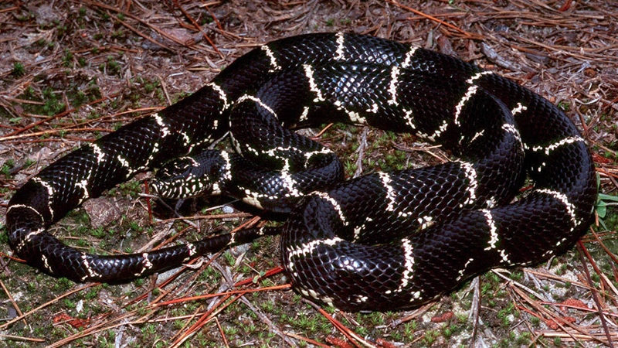
1

Slide 3
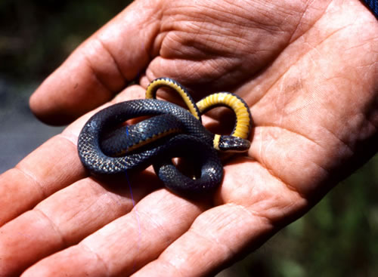
2

Slide 4
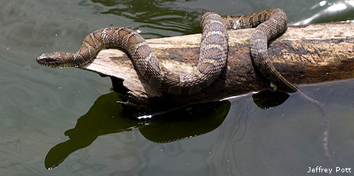
3

Slide 5
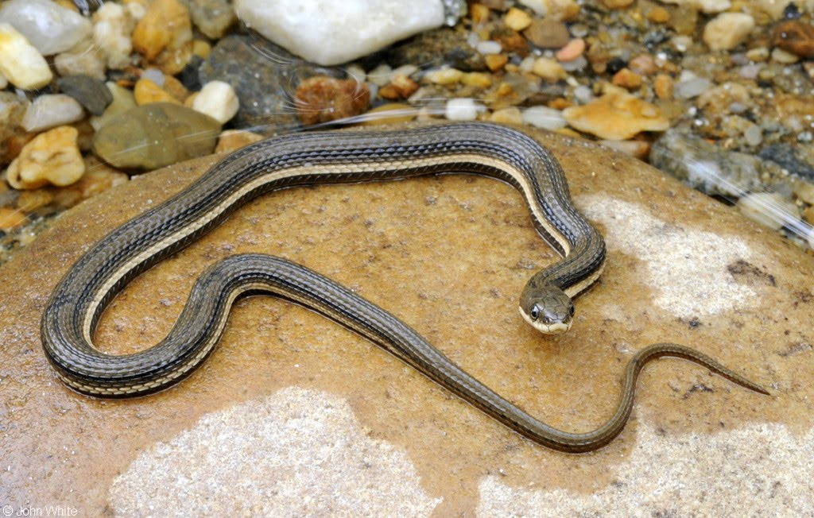
4

Slide 6
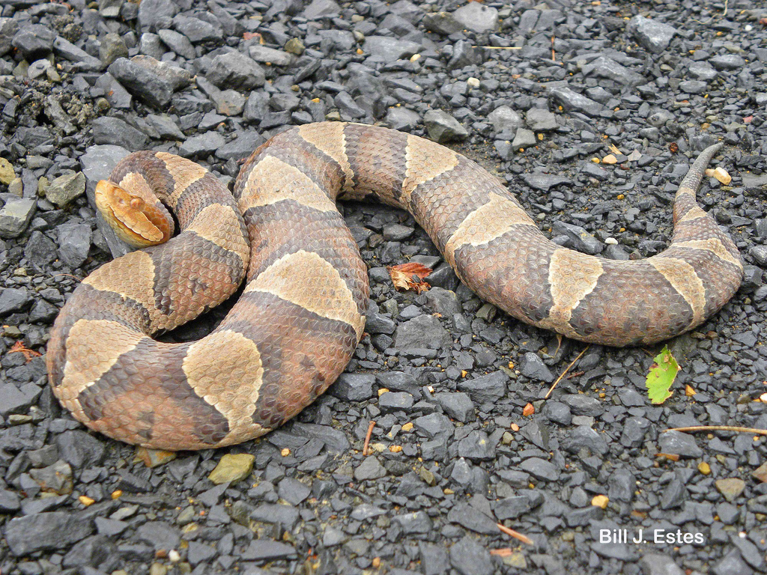
5

Slide 7
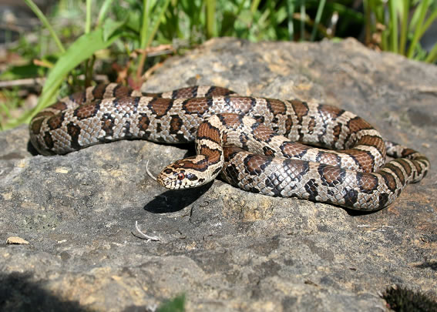
6

Slide 8
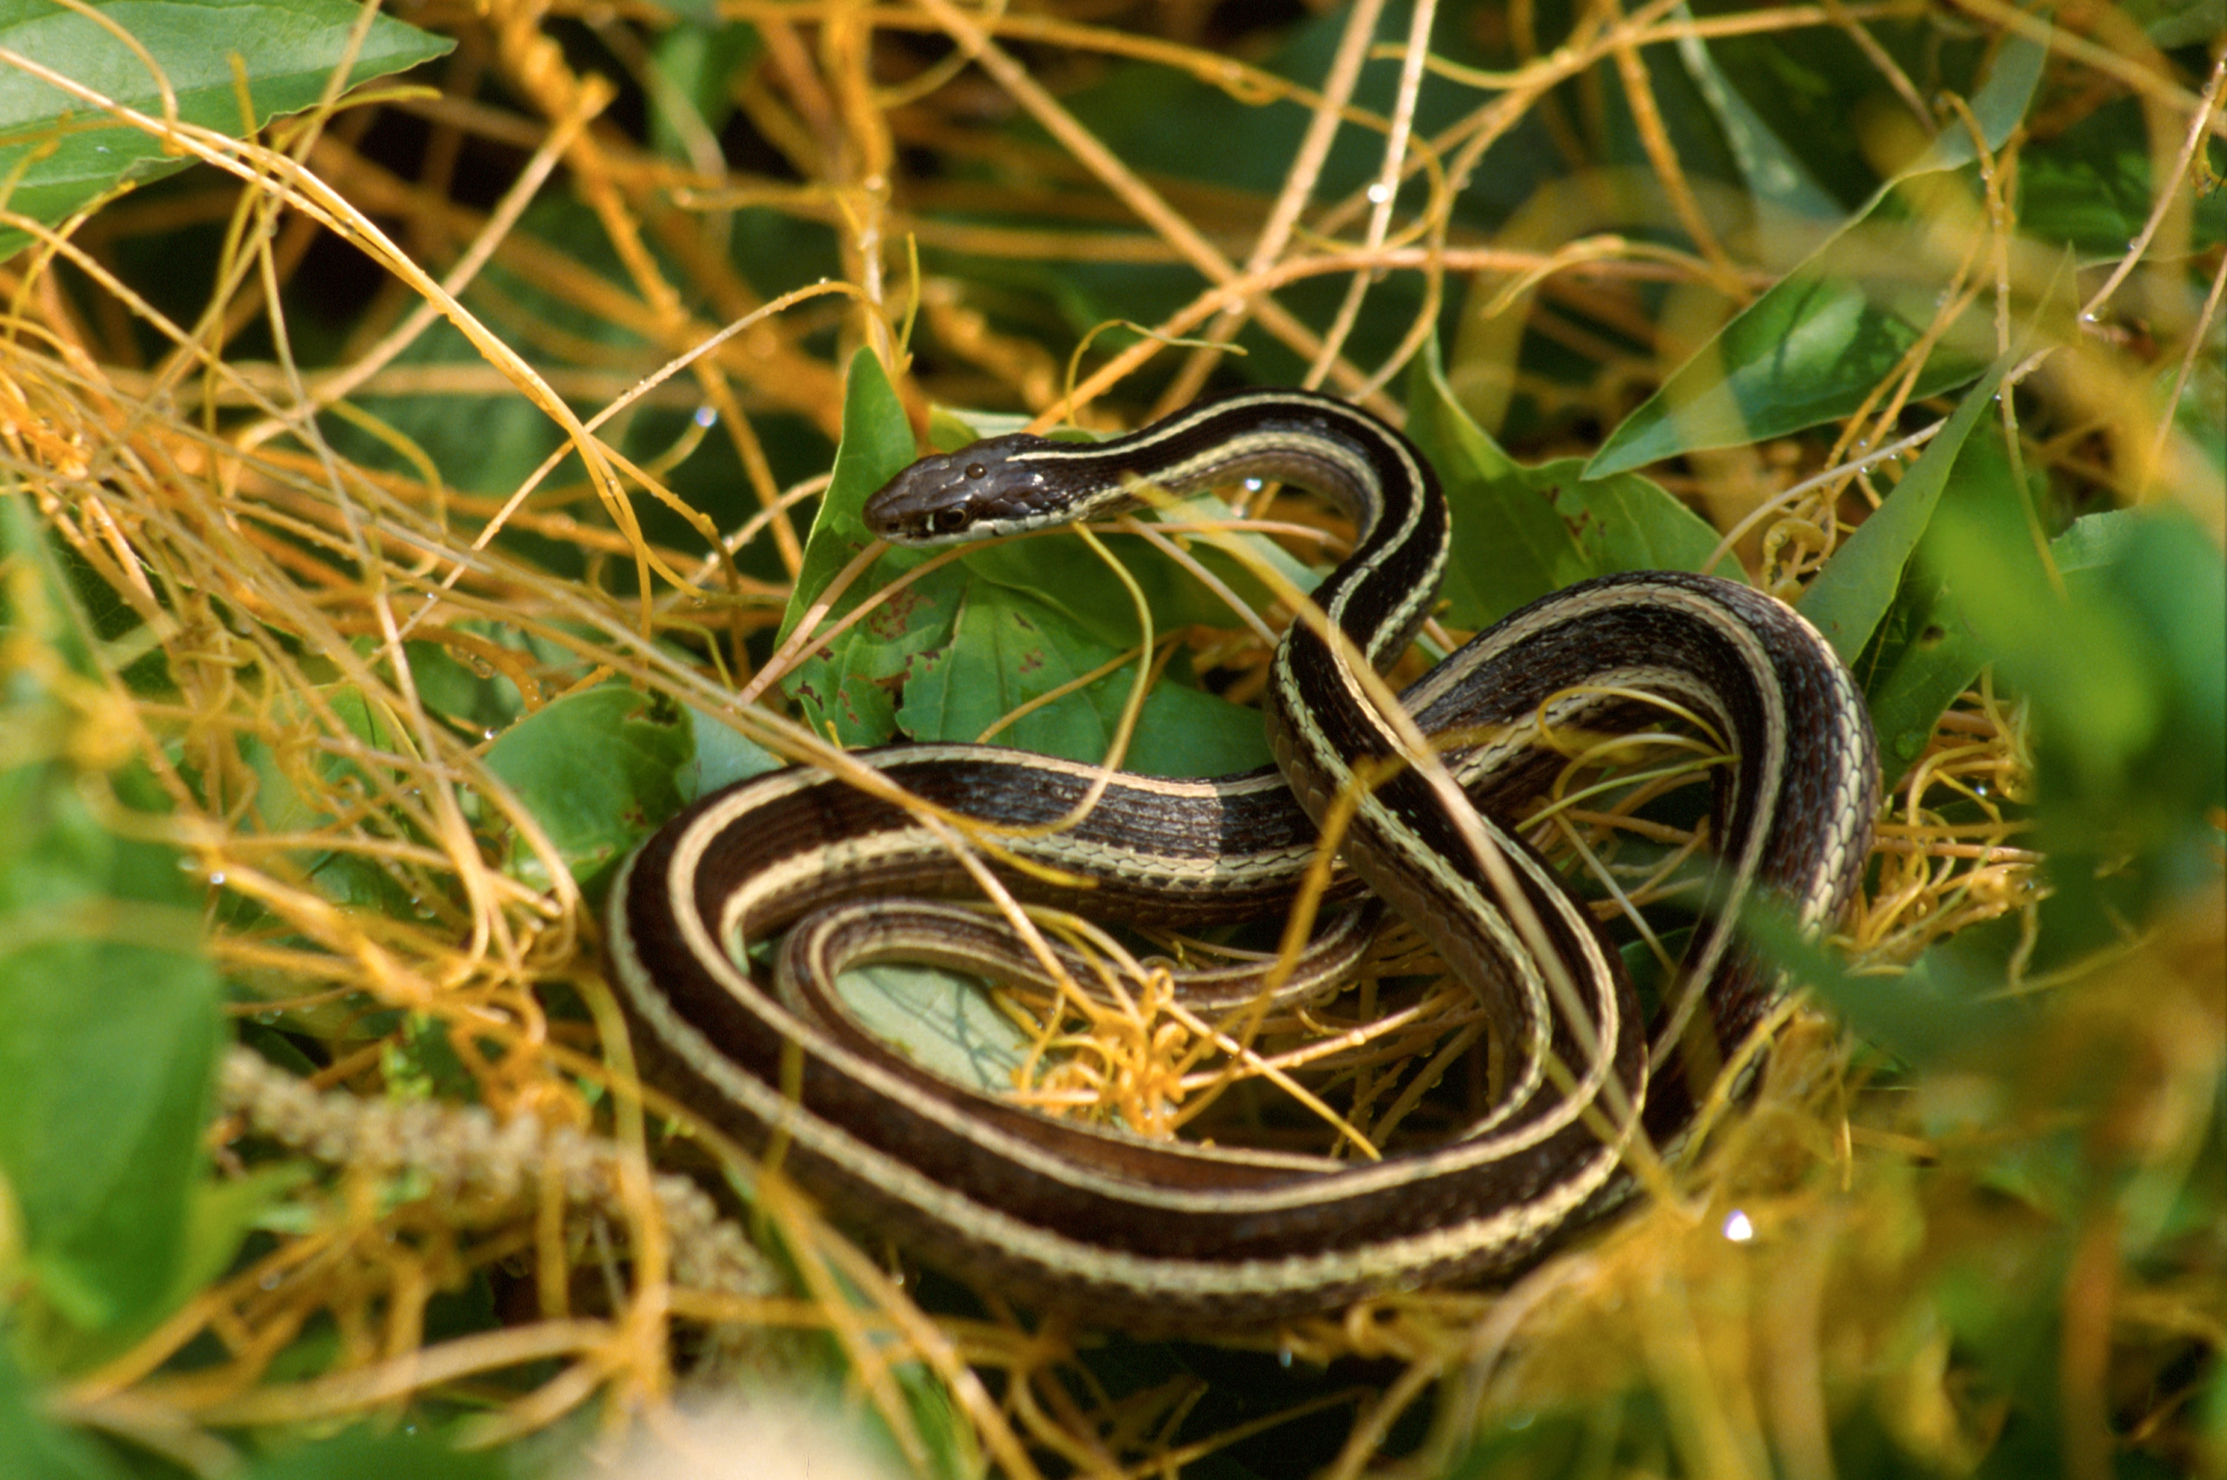
7

Slide 9
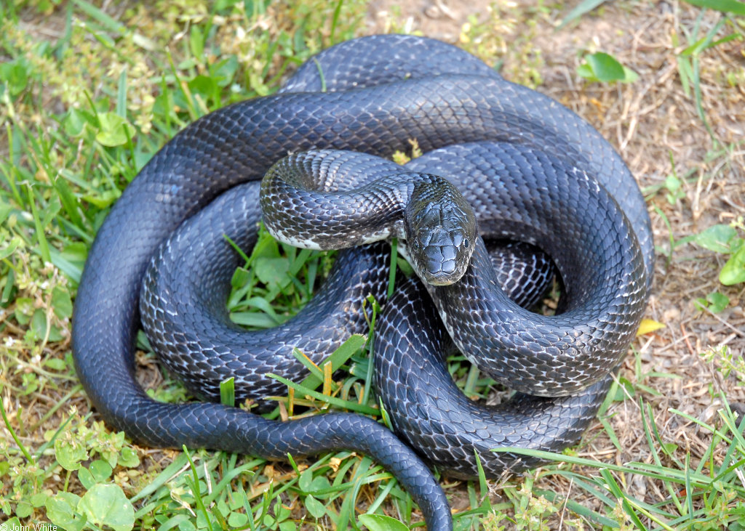
8

Slide 10
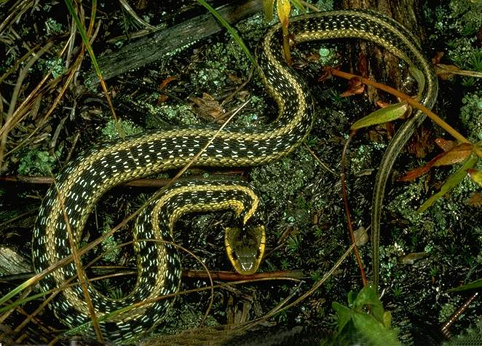
9

Slide 11
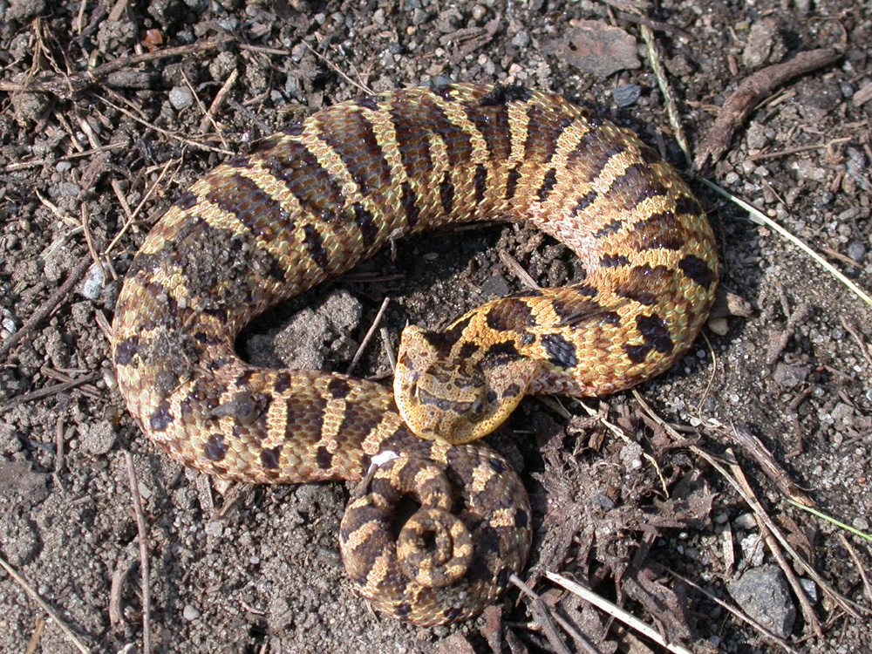
10

Slide 12
1 = King snake
2 = Ringneck snake
3 = Northern Water snake
4 = Queen snake
5 = Copperhead
6 = Eastern milksnake
7 = Ribbon snake
8 = Black rat snake
9 = Garter snake
10 = Hognose snake

